Slide 1

Ching-Wen Chen
Translated from Chinese (Simplified) to English - www.onlinedoctranslator.com
Search Engine Marketing (SEM)
and Search Engine Optimization (SEO)
Implementation

Slide 2
Unit Outline
What is called【Organic traffic】
Marketing using search engines is called【SEM, search engine marketing】
How can I improve my website's organic search ranking?
GoogleThe key to ranking a website is【Good content quality, high website authority, and good user experience】
This semesterSEOWeb page implementation steps
Keywords are4Intention Type
【Newbie Page】The strategy is: first【Long tail keywords】Getting Started
Web Settings【SEOKeywords】How long will it take to see results?
Where to get these【SEOKeywords】Woolen cloth?(Google ads）
Implementation: Place the mineral water product article20PieceGoogleMonthly search for long tail keywords
Implementation:【Optimize pictures】Add web images【src, alt, titleText description of】

Slide 3
1.Definition and Importance of SEO
What is SEO:
SEO (Search Engine Optimization) is a set of techniques and strategies.
The purpose isImprove your website's ranking in search engines,
HenceIncrease website visibility and traffic.
Importance of SEO:
In the modern Internet, search engines are the primary tool for users to discover content.
Through effective SEO, your website can stand out in relevant searches and attract more target customers.

Slide 4
What is called【Organic traffic】

Slide 5
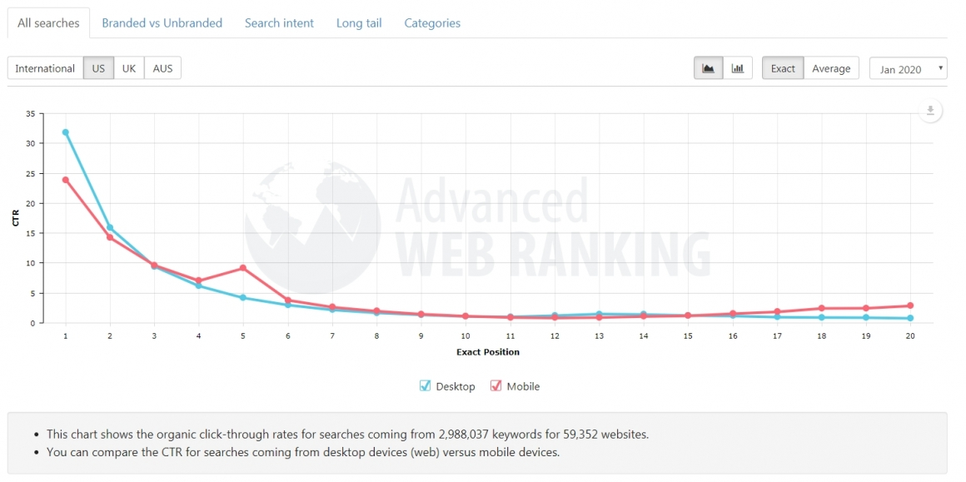
The horizontal axis represents ranking position, and the vertical axis represents traffic. The higher the ranking, the greater the traffic.
【Organic traffic】Organic Traffic
means throughNon-payingway, naturally fromSearch engine traffic to the website.
These visitors arepass throughSearch Engine(likeGoogle,Bingetc.) and then click on the website link in the search results to enter the.
Organic traffic does not include paid advertising or any form of promotional traffic.
Instead, it depends on the quality of the website's content and search engine optimization (SEO) to attract visitors.

Slide 6
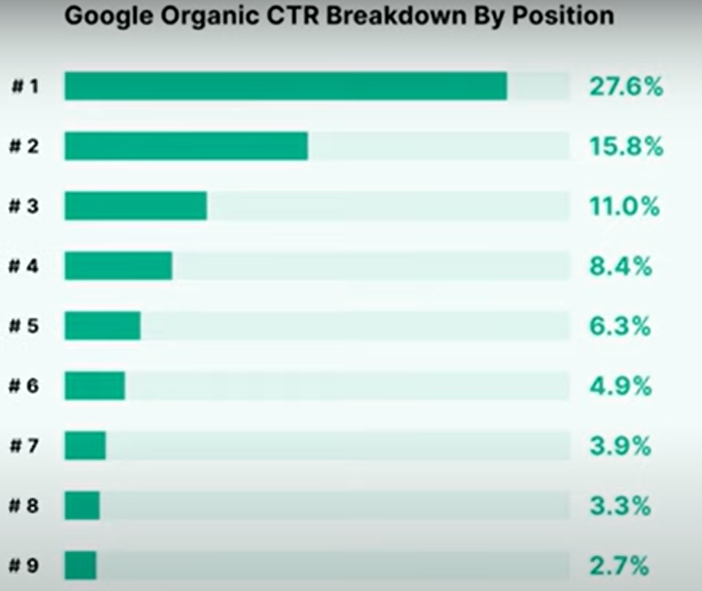
The traffic for the first position in Google search results reaches as high as 27.6%.

Slide 7
The relationship between organic ranking and click-through rate (CTR)
☎SEONatural ranking=Free website ranking
☎googleAfter entering the keyword query data, the first few entries areAdvertising Page, the following isgoogleaccording toSEORanked's website.
Practice:googleInput:refrigerator
QuerySEOOrganic rankingThe top few
☎SoSEOThe goal is to get your website ranked higher.
☎Ranking higher will increase traffic and promote marketing.
☎The following figure proves the relationship between organic ranking and click-through rate. It can be clearly seen that the higher the ranking, the better.

Slide 8
So, it is possible to drive traffic to your website without spending money, relying solely on Google search
Organic traffic → is free traffic

Slide 9
Organic traffic
Organic traffic→that isFree traffic
You can attract customers without spending money on advertising.
This is something every company needs to spend some time researching.

Slide 10
The method of using search engines for marketing is called
【SEM, Search Engine Marketing】

Slide 11
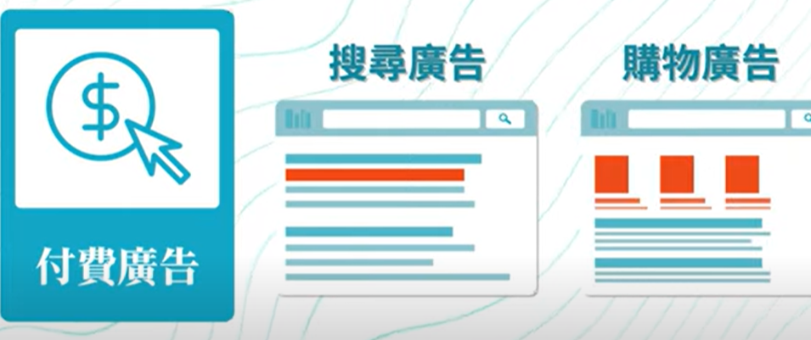
There are two types of Search Engine Marketing (SEM).
No.1Type:Paid Advertising→Bring【Paid data】
No.2Type:Search keywords→Bring【Organic traffic】

Slide 12
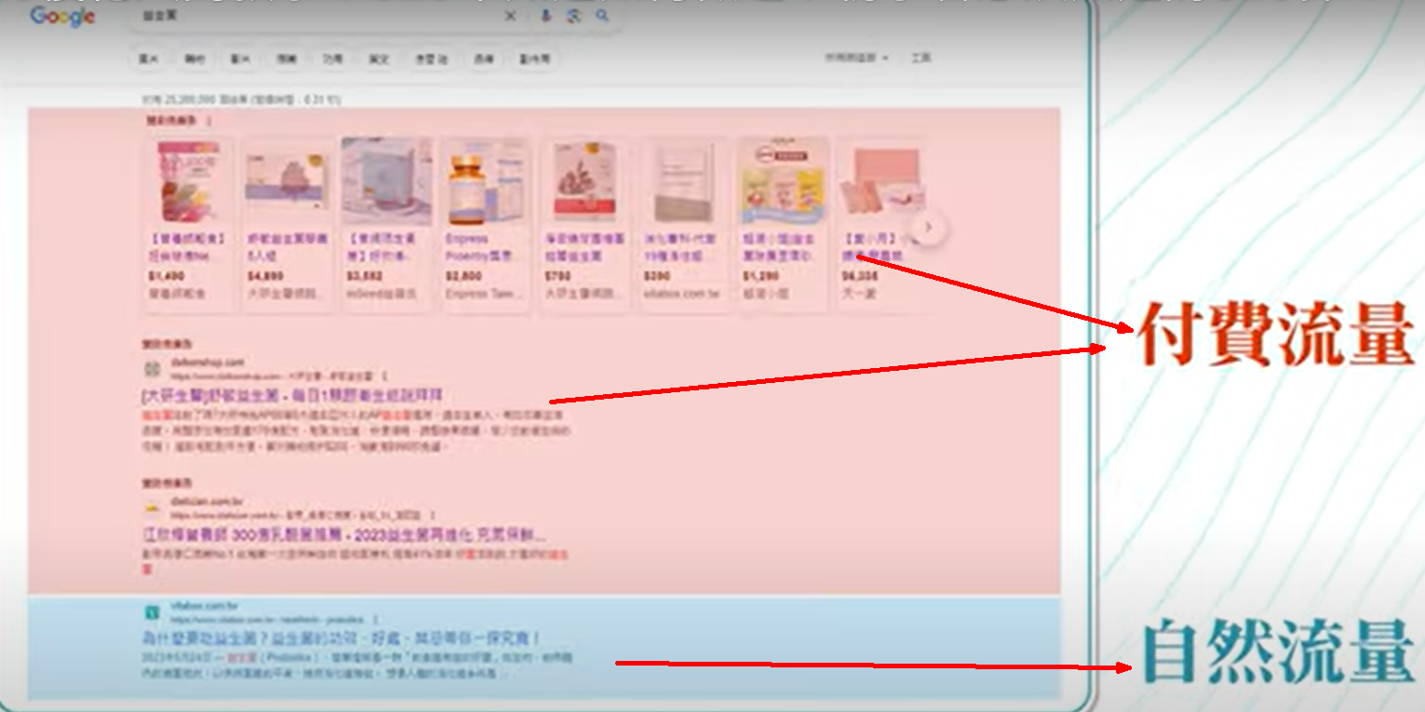
There are two types of Search Engine Marketing (SEM).

Slide 13
How can I improve my
The site's organic search ranking?

Slide 14
Doubts:
How does the Google search engine calculate ranking and order?

Slide 15
How does the Google search engine calculate ranking and order?
GoogleSearch engine ranking and sorting is done through aComplex algorithmsTo decide,
This algorithmMany factors will be consideredto determine the ranking of each web page in the search results.
GoogleNot announcedRanking algorithm formula
However, the following factors will probably be considered:

Slide 16
How does the Google search engine calculate ranking and order?
1.Keyword relevance(Keyword Relevance)
GoogleThe content of a web page is analyzed to determine whether the page is relevant to the user's search term. The presence of keywords in the title, content, tags, and the naturalness of the content all affect relevance.
2.WebsiteContent qualityMust be good
The depth, uniqueness, professionalism and ability to meet user needs are the key factors forGoogleAn important factor in the evaluation. High-quality, authoritative content is more likely to rank higher.

Slide 17
How does the Google search engine calculate ranking and order?
3.Website authority(Domain Authority)
The authority of a website is based on the trust other websites have in it, which is usually reflected in the backlinks (backlinks) in terms of quantity and quality. Backlinks from high-authority websites will improve your website's ranking.
Navigational or transactional queries. Different search intents may lead to different ranking results.
4.User Experience(User Experience)
GoogleEvaluate the user experience of the webpage, such as how fast the page loads, whether it is suitable for mobile devices (mobile-friendliness), ease of navigation, etc. A good user experience usually improves rankings

Slide 18
How does the Google search engine calculate ranking and order?
5.Page structure(Page Structure)
The structure and format of the web page (such asH1,H2Use of labels, imagesaltText, etc.) will also affect rankings. A good page structure helps search engines better understand and index page content.
6.User engagement metrics(User Engagement Metrics)
GoogleIt takes into account user behavior on the web page, such as bounce rate, dwell time, click-through rate, etc. High engagement usually indicates that the content is attractive to users and helps improve rankings.

Slide 19
How does the Google search engine calculate ranking and order?
7.Freshness(Freshness)
For some queries, freshness of the content is also a consideration.GoogleNewer content will be shown first, especially for search terms that are relevant to timeliness.
8.Geographical location and localSEO
The searcher's geographic location also affects the ranking of results.GooglePrioritizes local results that are relevant to the searcher's location, particularly local businesses or services.

Slide 20
The key factors for Google ranking a website are:
High-quality content
High website authority
Good user experience

Slide 21
Key factors for Google website ranking:
1.Content qualitygood:
UserYou can get what you want to know from it
Make full use of multimedia: articles, pictures, videos
2.The website is highly authoritative and professional:
Cited by many external websites
Recommended by many
3.Good user experience:
Fast web page loading speed
On mobile,flat,Computer, all platforms can read

Slide 22
Question:
Since Google values high-quality content, does that mean our company's website only needs to focus on producing good content and doesn't need to worry about keywords, Right?

Slide 23
Of course not.

Slide 24
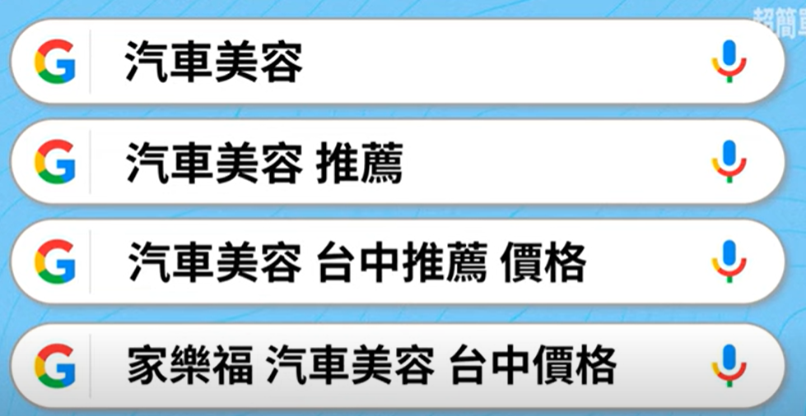
Could your company's (automotive coating) webpage include the following popular keywords?

Slide 25
Could your company's (automotive coating) webpage include the following popular keywords?
If the web page does not have the following content text
This netizen cannot quickly find your company website.

Slide 26
Why is keyword research still necessary?
UserThe keywords you entered may not be able to find your company(Mineral water)Web page of:
For exampleuserInput:【Healthy drinking water】,or【Mountain spring water】
Your company might not appear(Mineral water)Web page
SearchSearch EngineRecent hot keywords:
KeywordsIt is still the search engine that understands the topic of the web page.Important indicators.
Incorporating appropriate keywords naturally into your articles will help increase your page's visibility in relevant searches.

Slide 27
So, keyword research is the first step in doing SEO.
As a result, there are now four key factors for handling Google website ranking.

Slide 28
The four key factors for handling Google website ranking.
1.Keyword Research:
Bundle【Hot Keywords,Long tail keywords,Trading Keywords】Insert article content
The search keyword is a popular one that changes frequently.
Therefore, the article should be revised regularly【Hot Keywords】
2.Content qualitygood:
UserYou can get what you want to know from it
Make full use of multimedia: articles, pictures, videos
3.The website is highly authoritative and professional:
Cited by many external websites
Recommended by many
4.Good user experience:
Fast web page loading speed
On mobile,flat,Computer, all platforms can read

Slide 29
This semester SEO Web page
Implementation steps

Slide 30
Practical Steps for SEO Webpage Implementation This Semester
1.Conduct keyword research:
useGoogle Ads,Google Trends or other keyword research tools,
Find products related to yours【Hot Keywords,Long tail keywords】
This will help you better understand market demand.
2.Naturally incorporate keywords:
When writing a product introduction article, naturally incorporate the keywords you researched into the content.
Avoid excessive keyword stuffing, so as not to affect the readability of the content and the user experience.

Slide 31
Optimize pictures
3.Emphasize the usefulness and value of the content:
While optimizing keywords, make sure the content of the article has real value to the readers. Provide detailed, accurate and useful information to meet the needs of users.
4.Optimize images:
Make sure the image has【Descriptive file names】and【 altTags】
TheseTagsCanContains keywords
Help search engines understand the content of the image.
At the same time, the image is enhancedGoogleVisibility in image search.

Slide 32
Correct SEO Web page implementation steps
5.TechnicalSEO:
Ensure:
The website has a good technical structure(Requiredmenuor hierarchy branchesmenu）
Fast page loading speed(Don't load files or videos that are too large)
And suitable forVariousMobile devices(Use responsive web pagesRWD）
These technical factors haveSEOIt also has an important impact.

Slide 33
Correct SEO Web page implementation steps
1.Conduct keyword research:
useGoogle AdsFind out【Hot Keywords,Long tail keywords】
2.Naturally incorporate keywords:
select5~10KeywordsBlend naturally into the content.
Avoid excessive keyword stuffing, so as not to affect the readability of the content and the user experience.
3.Emphasize the usefulness and value of the content:
4.Optimize images:
Make sure the image has【Descriptive file names】and【 altTags】
TheseTagsCanContains keywords,Boost images inGoogleVisibility in image search.
5.TechnicalSEO:
The website has a good technical structure(Requiredmenuor hierarchy branchesmenu）
Fast page loading speed(Don't load files or videos that are too large)
And suitable forVariousMobile devices(Use responsive web pagesRWD）

Slide 34
This course will only cover the four core elements that enhance organic traffic.

Slide 35
2.Core Elements of SEO
1-Keyword Research:
selectRelevant to the content of the site andHighly searched keywords, which is the foundation of SEO.
2-Website structure optimization:
Good website structureIt helps search engine crawlers to index website content more easily.
include:Clear navigation,andInternal link structure.
3-WebsiteContent qualityMust be good(Practical, easy to attract people to stay):
High-quality contentAble toAttract visitors and increase their staytime, which helps to improve rankings.
4-Backlinks:
Links from other websites,Can improve the authority of the website,
This has a significant impact on search engine rankings.

Slide 36
There are four types of keyword intent.

Slide 37
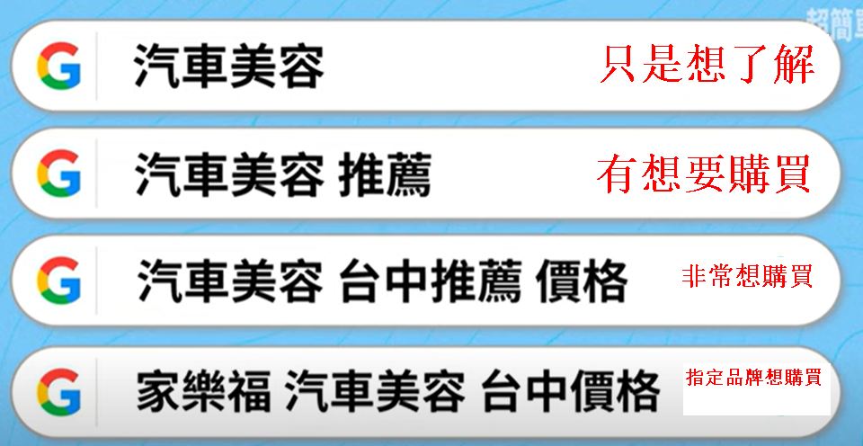
There are four types of keyword intent.

Slide 38
Which of these four types of keyword intent has the highest monthly search volume?

Slide 39
Which has the most monthly searches?
No.1Kind【Just want to know】
Most searches are【Just want to know】, I don't want to buy
Search volume: Most, about110,000100ten thousand
Called:【Core keywords】

Slide 40
Which has the least monthly searches?
No.3,4Kind【Multiple keyword combinations】
Called:【Long tail keywords】
Intention:Very interested in buying

Slide 41
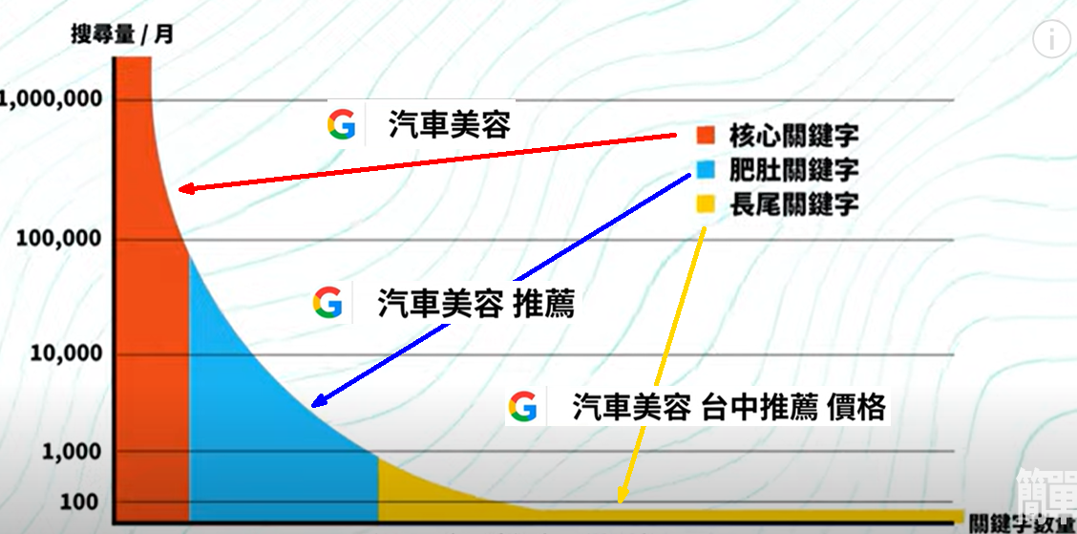
Search Volume Distribution Chart for the Four Types of Keyword Intent

Slide 42
Question:
Which of the three types of **SEO keywords** do you think should be set for the webpage to significantly increase my website traffic?

Slide 43
What kind of keywords should I set to make my 【Newbie Page】Traffic volume increased significantly?
1.If you set【Core keywords】:Car detailing
Search volume/Month: can be achieved1010,000100ten thousand
This is【Very large flow】Source
existGoogleIf the engine ranks first2page, you can have a share of the pie(flow)
The problem is:【Matches this keyword】There are many websites,The competition is fierce.【Newbie Page】, can't be ranked in the front2Page

Slide 44
Strategy:
The strategy for a beginner website is to quickly boost your **credit rating** with Google in the short term.
Only then will Google increase your website's score and improve its ranking.

Slide 45
How to quickly boost your **credit rating** with Google in the short term.
1.【Strategy】:
Try to makeuserHere3There is a chance within a monthClick to your website,
And can stay1More than minutes
Because:As long as there isuserCan browse your website continuously and stay there, your【Credit Rating】The score will gradually increase

Slide 46
Strategy:
The strategy for a **beginner website** is to start by focusing on **long-tail keywords**.

Slide 47
The strategy for a **beginner website** is: Step 1: Start with **long-tail keywords**.

Slide 48
The strategy for a **beginner website** is: Step 1: Start with **long-tail keywords**.
reason:
1.There are relatively few websites that match long-tail keywords.Less competition
2.userSearch【Car detailing Taichung recommended prices】
2.your【Newbie Page】Will appearAfter the search1Page,
3.userIt's easy to hit your website
4.advantage:【Long tail keywords】Incoming traffic,Traffic with purchasing intention

Slide 49
The strategy for a **beginner website** is: Step 3: In the long term, focus on **core keywords**.
reason:
1.Once your website is frequently visited,【Credit Rating】will improve
2.At this timeuserSearch【Car beauty recommendations】,Your website will appear in the first1,2Page,
3.userIt's easy to hit your website

Slide 50
【Newbie Page】The strategic approach is: Steps3:Do it again in the long term【Core keywords】
reason:
1.Long-term operation, the website is constantly clicked, your【Credit Rating】Gradually improve
2.At this timeuserSearch【Car detailing】,Your website will appear in the first1,2Page,
3.userIt's easy to hit your website

Slide 51
This is the search engine marketing strategy for a **business website** using **SEO keywords**.

Slide 52
The point is
It is completely free marketing

Slide 53
In fact, **SEO keywords** are part of the process of improving Google's **credit rating** for your website.

Slide 54
Websites with a high **credit rating** will rank higher.

Slide 55
Question:
How long does it take to see results after setting **SEO keywords** on a webpage?

Slide 56
How long does it take to see results after setting **SEO keywords**?
It's about your competitors.If they are also constantly modifying the web pageSEO, the ranking will also move forward
Interim response deadline:6Month:
Most websites will have4arrive6Within a month, you will start to see more obviousSEOEffectiveness,For example, the keyword ranking is significantly improved and the traffic increases significantly..

Slide 57
Question:
Since adding popular keywords to an article helps users find my webpage, wouldn't it be better to include dozens of popular keywords?

Slide 58
Can the article contain many popular keywords?
Can't
Because in2023Year,GoogleAnnouncement,
If a web page contains too many keywords, the reading experience of the article will be poor.If
Page ranking will deteriorate
Many early web pages were deceptive in this way.GoogleSearch Engine

Slide 59
Question:
Where can I obtain these **SEO keywords**?

Slide 60
Two free methods to obtain **SEO keywords**
method1:arriveChatGPT4o(The ____ does not work3.5version)
GetLong-term stability【Common keywords】
method2:arriveGoogle adsQuery
Get【Hot keywords, long-tail keywords】
And moreSEOTools are available, but they cost money, every month110Yuan

Slide 61
Using Google Ads to obtain 【Keyword list】

Slide 62
Using Google Ads to obtain a 【keyword list】 ranked by monthly search volume.
2PieceGoogletools, all lead to the same screen.
(1). Google ads:
https://ads.google.com/
Can provide【SEOMonthly searches for】ranking
(2). Google Keyword Planner:
Omit half of the settings, simpler
Can provide【SEOMonthly searches for】ranking

Slide 63
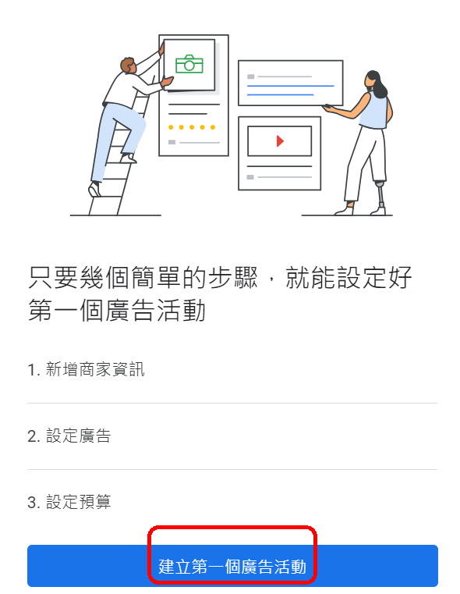
Using Google Ads to obtain a 【keyword list】 ranked by monthly search volume.
(1). Google ads:
After logging in, you will be forced to create1Ads

Slide 64
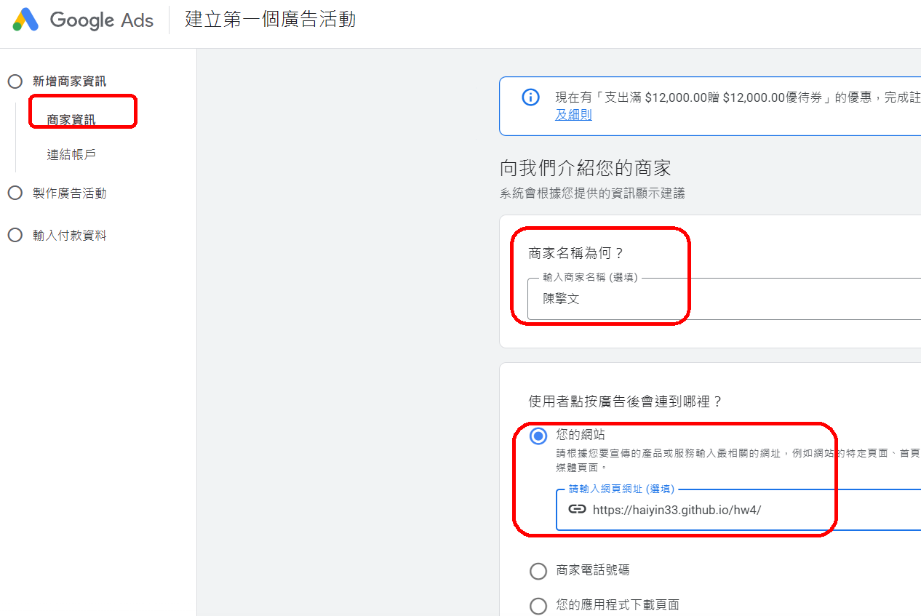

Slide 65
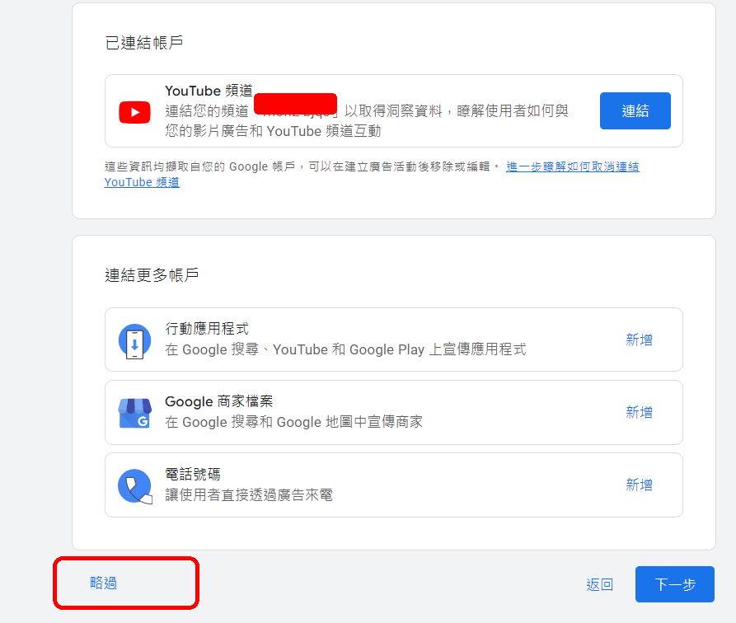

Slide 66
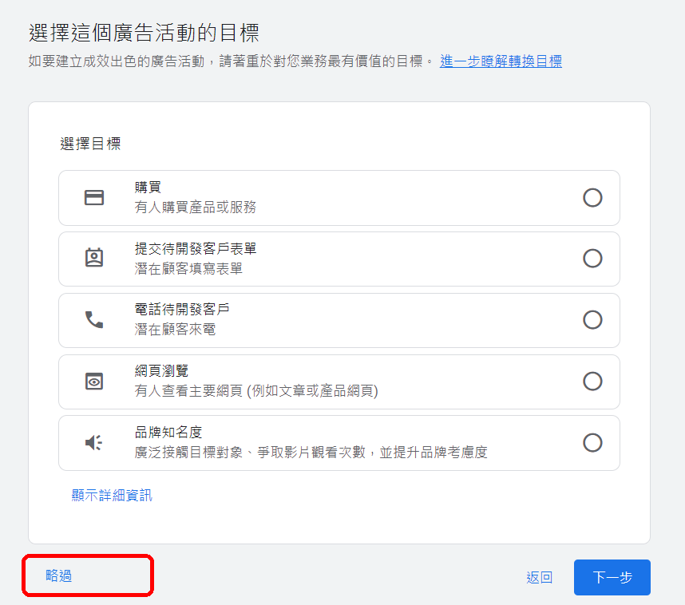

Slide 67
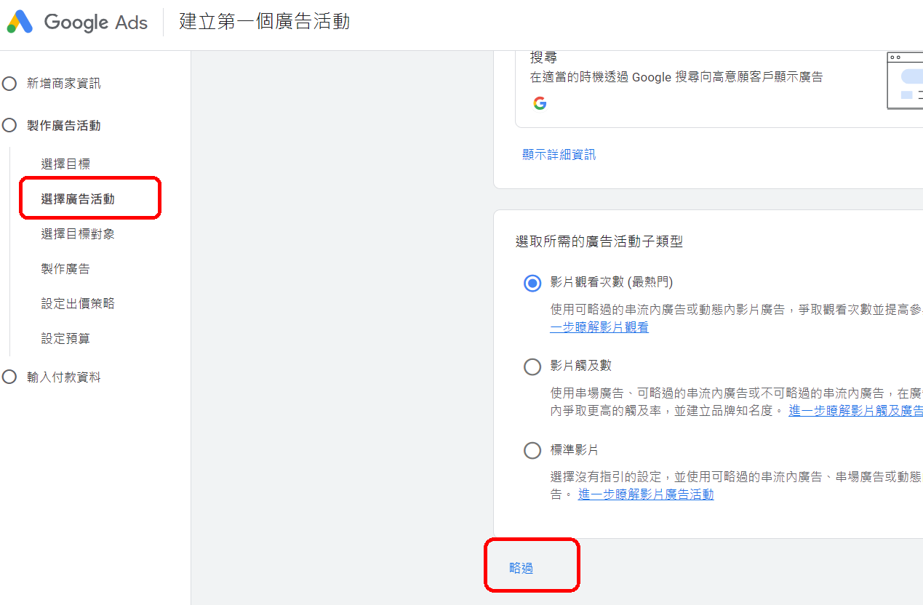

Slide 68
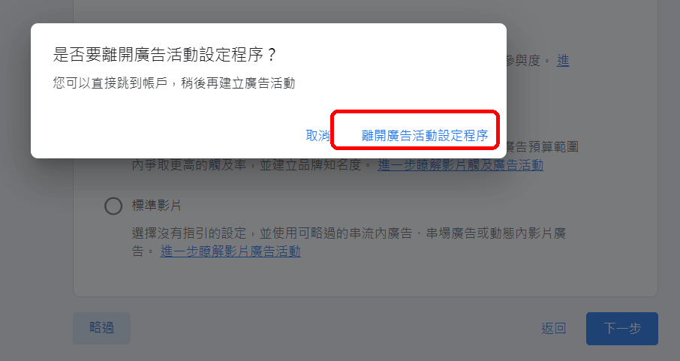

Slide 69
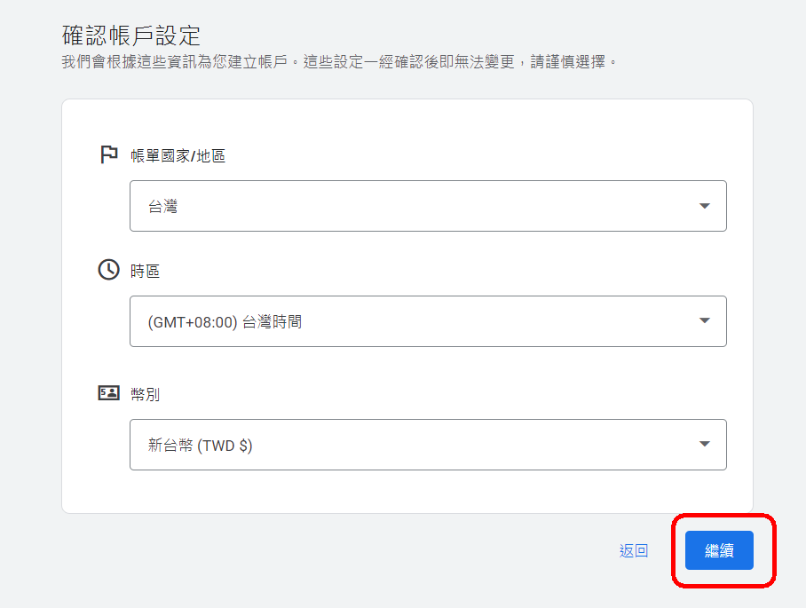

Slide 70
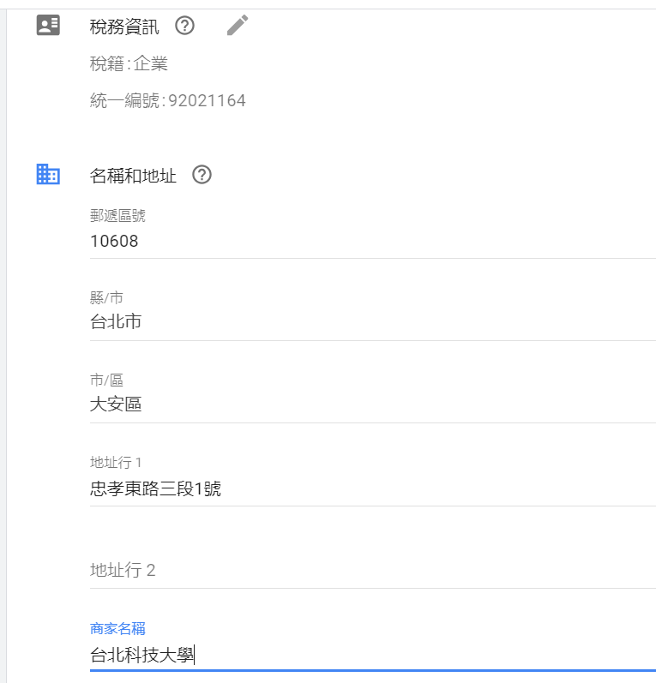
台北科技大學，統編：92021164 10608台北市大安區忠孝東路三段1號
台北科技大學，
統編：92021164
10608
台北市大安區
忠孝東路三段1號

Slide 71
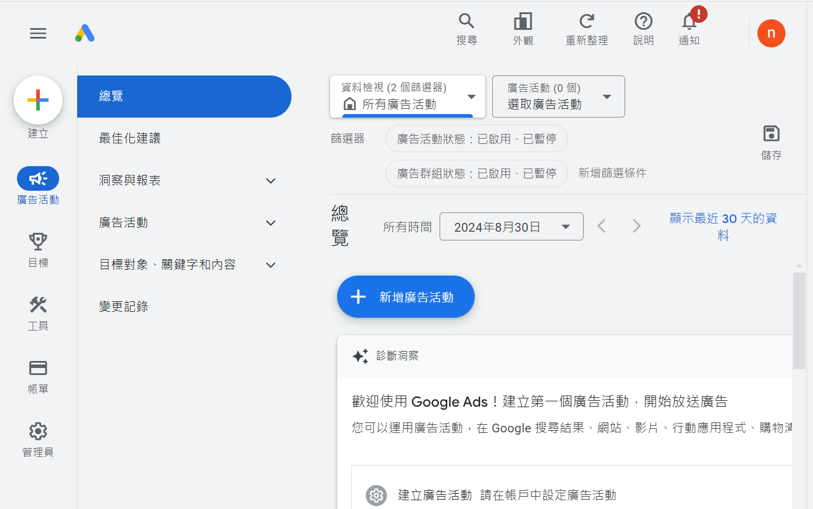
Setup complete screen.

Slide 72
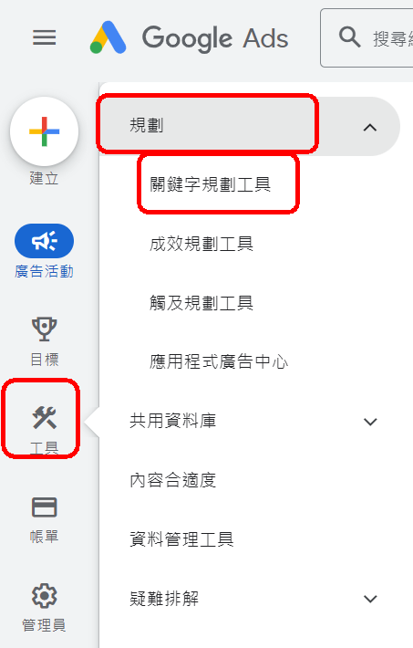
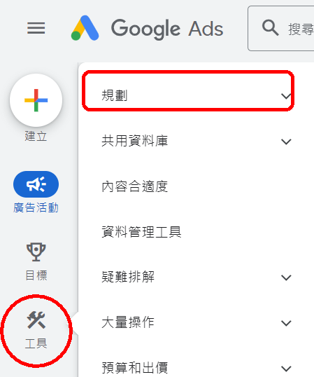
Using Google Ads to obtain a 【keyword list】 ranked by monthly search volume.
【tool】→【Keyword Planner】

Slide 73
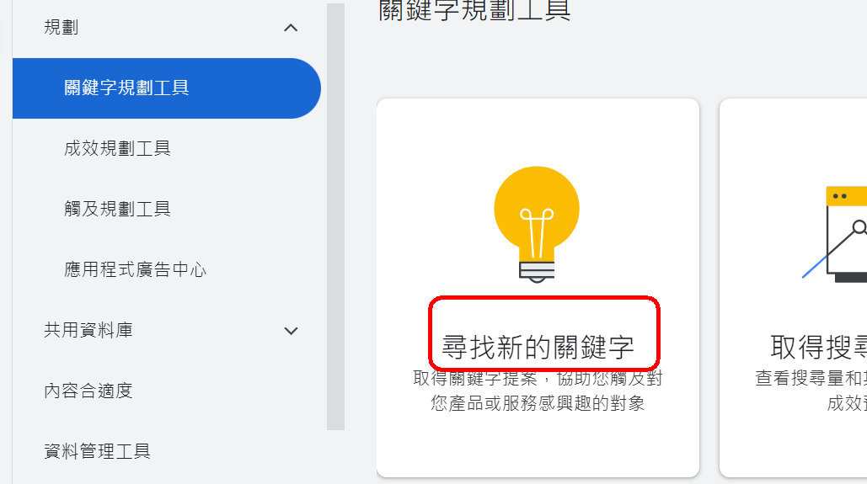
Using Google Ads to obtain a 【keyword list】 ranked by monthly search volume.
【tool】→【Keyword Planner】→【Find newKeywords】

Slide 74
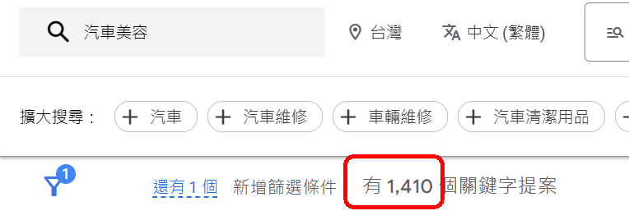
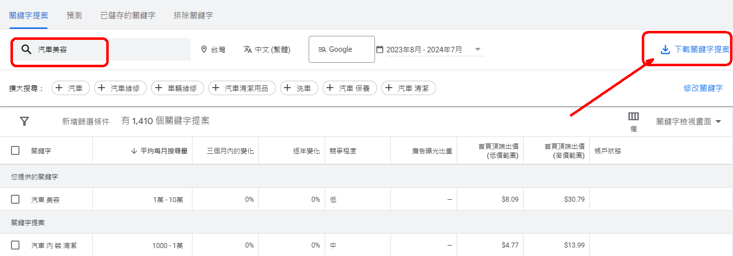
Query: 汽車美容→ A total of 1,410 keywords.
DownloadcsvFiles

Slide 75
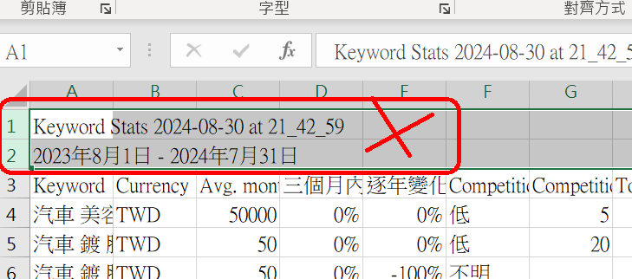
Open Excel (CSV)
Steps1.Before deleting2List

Slide 76
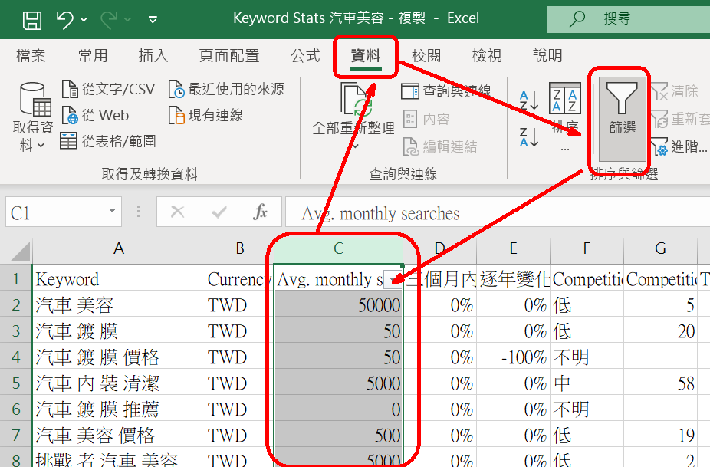
Open Excel (CSV)
Steps2.Filter【Avg. monthly searches】Field

Slide 77
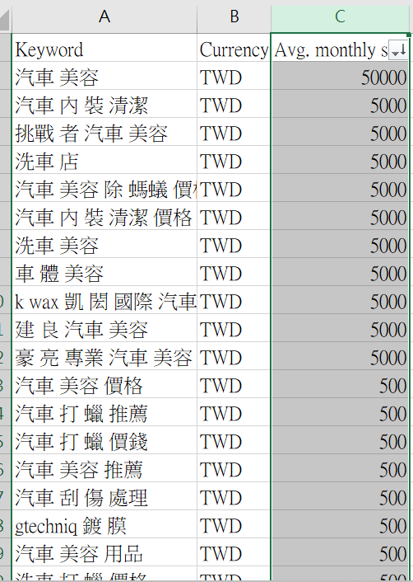
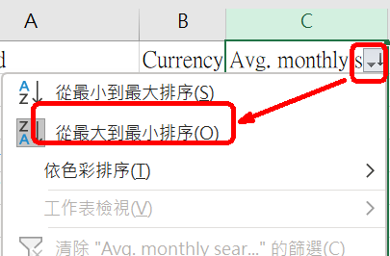
Open Excel (CSV)
Steps3.Sorting【Sort from largest to smallest】

Slide 78
Copy the keywords with a search volume of over 500 to ChatGPT 4.0
Steps4.Remove keywords that contain company names
arriveChatGPT4o, give the following command:
Here are mygoogle adsI have found a list of average monthly search keyword names and search volumes. Please help me eliminate those keywords targeting specific company names and find20Long tail keywords for me
---
Car detailing50000
Car Interior Cleaning5000
Car detailing and ant removal price5000
Car interior cleaning pricesptt5000
k waxKaihongInternational Car Detailing MaterialsOEM5000
JianliangCar detailing5000
Car wash and detailing5000
Car Body Beauty5000
HaoliangProfessional car detailing5000

Slide 79
Step 5: ChatGPT 4.0 selects 20 long-tail keywords
Car interior cleaning (5000searches)
Car detailing and ant removal price (5000searches)
Car interior cleaning pricesptt（5000searches)
Car wash and detailing (5000searches)
Car body detailing (5000searches)
Car wash (5000searches)
Car waxing recommendation (500searches)
Car scratch treatment (500searches)
Beauty Magnet500searches)
Car interior maintenance (500searches)
Car beauty scratch repair (500searches)
Car wash interior cleaning (500searches)
Car wash waxing recommendation (500searches)
Car detailing and repainting (500searches)
Car body coating price (500searches)
Car Partial Polishing Price (500searches)
Car detailing materials wholesale (500searches)
Car interior cleaning prices (500searches)
Manual car wash waxing price (500searches)

Slide 80
Step 6: Ask ChatGPT 4.0 to integrate these 20 keywords into your webpage article.
Below is the product article I wrote, and a list of long-tail keywords. Please help me add the long-tail keyword list to the product article. The sentence must be reasonable. There are many reading experiences.
Finally, send me the full article content after adding the keywords (please add【】Symbol)
----------
Product Articles
....
....
....
----------
Keyword list
Car Interior Cleaning
Car detailing and ant removal price
Car interior cleaning pricesptt
Car wash and detailing
Car Body Beauty
....
....

Slide 81
Implementation:
Insert 20 long-tail keywords with high monthly search volume from Google into the article about mineral water products.

Slide 82
Step 1: Write the draft of the mineral water product article.
The simpler it is, the more Yueshi is not simple
Yueshi attaches great importance to environmental protection, has an optimized production process, adheres to the purpose of consumer health, and constantly pursues innovation and excellence. The goal is to allow everyone to conveniently enjoy natural and healthy products.
★Yue's mineral water from the snowy mountains
The source of Yue's mineral water is adjacent to the Snow Mountain National Primitive Forest Reserve, and the water catchment area is traced back to15The water source of Yueshi is naturally flowing out after being filtered through the volcanic shale layers of the Snow Mountain Range. The water quality is not only naturally pure, but also contains a balanced amount of calcium, magnesium, sodium, iron, fluorine and other minerals, which is the most precious gift of nature.
★For the purity of every drop of water, Yueshi bought a piece of mountain.twenty fourThe seemingly simple good water is guarded by a dedicated person all the time, which all comes from Yueshi’s not-so-simple persistence.
★Yueshi mineral water with professional production process
Yueshi to preserve100%The natural mineral water flavor of Yueshi has been made by itself since the factory was built. It is the first mineral water factory in the country to be equipped with a bottle blowing machine. From the arrangement, cleaning, disinfection, labeling, filling, all the machines and equipment from advanced countries are selected. Yueshi combines the power of people and technology to provide consumers with the most natural, pure and healthy mineral water. Yueshi also meets the mineral waterTQF,HACCP,andISO22000Internationally certified operating procedures are used to control the production operations of the entire factory, and all factory personnel are required to ensure the "natural purity of water" at their work posts.

Slide 83
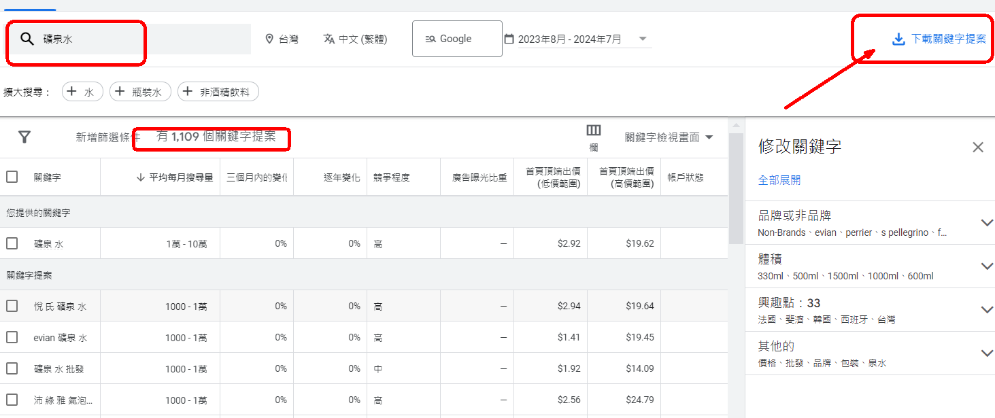
Step 2: Use Google Ads to look up the monthly search keywords for mineral water.
Download KeywordscsvFiles

Slide 84
Step 3: Filter the column and copy keywords with a search volume > 500, then paste them into ChatGPT.
Here are mygoogle adsI have found a list of average monthly search keyword names and search volumes. Please help me eliminate those keywords targeting specific company names and find20Long tail keywords for me
----------
Yue's Mineral Water
evian Mineral water
Mineral Water Wholesale
Perrier Sparkling Water
San Pellegrino Sparkling Mineral Water
Evian mineral water
Mineral water recommendation
evian mineral water
Customized mineral water
Yue's Mineral Water330ml
Babu Nong Natural Alkaline Mineral Water
perrier Sparkling water
Babunong Mineral Water

Slide 85
Step 4: The 20 long-tail keywords after filtering:
Mineral Water Wholesale
Mineral water recommendation
One box of mineral water
Small bottle of mineral water
Magnesium Spring Water
Mineral Water Customization
Mineral Water Wholesale Price
Mineral water delivered to your home
Imported mineral water
Mineral water330ml
Premium mineral water
Bubble mineral water
Natural sparkling water
Mineral water delivery
Mineral water bottle
Natural mineral water
Alkaline mineral water
Mineral water brand
Mineral water prices
Taiwan Mineral Water Ranking
Snow Mountain Mineral Water
1000ccMineral water
2000ccMineral water
5Liter of mineral water
6Liter of mineral water
6000ccMineral water
600mlMineral water

Slide 86
Step 5: Ask ChatGPT 4.0 to incorporate the long-tail keyword list into the product article.
Below is the product article I wrote, and a list of long-tail keywords. Please help me add the long-tail keyword list to the product article. The sentence must be reasonable and have a lot of reading experience. Finally, give me the full article content after adding the keywords (please add the keywords before and after the keywords).【】Symbol)
---------- --
The simpler it is, the more Yueshi is not simple Yueshi attaches great importance to environmental protection and has the best
….
….
-------------
Mineral Water Wholesale
Mineral water recommendation
One box of mineral water
Small bottle of mineral water
Magnesium Spring Water
Mineral Water Customization
Mineral Water Wholesale Price
Mineral water delivered to your home
Imported mineral water
Mineral water330ml
Premium mineral water
Bubble mineral water
Natural sparkling water
Mineral water delivery
Mineral water bottle
Natural mineral water
Alkaline mineral water
Mineral water brand
Mineral water prices
Taiwan Mineral Water Ranking
Snow Mountain Mineral Water
1000ccMineral water
2000ccMineral water
5Liter of mineral water
6Liter of mineral water
6000ccMineral water
600mlMineral water

Slide 87
Step 6: The product article after adding the keywords
The simpler it is, the more Yueshi is not simple
Yueshi attaches great importance to environmental protection, has an optimized production process, adheres to the purpose of consumer health, and constantly pursues innovation and excellence, with the goal of making it convenient for everyone to enjoy【Natural mineral water】This is a healthy product from nature. Whether you are buying it for yourself or looking for【Mineral Water Wholesale】,【Yue's Mineral Water】Can meet your needs.
★Yue's mineral water from the Snow Mountain Range
Close to the Yue's Mineral Spring Water Source【Snow Mountain Mineral Water】National virgin forest reserve, watershed upstream15The water source of Yueshi is from【Snow Mountain Range】The volcanic shale is filtered and naturally emerges.【Premium mineral water】Not only【Natural and pure】, and contains a balanced amount of calcium,【Magnesium Spring Water】Minerals such as chrysanthemum, sodium, iron, and fluorine are the most precious gifts from nature.【Small bottle of mineral water】Still【One box of mineral water】For packaging, Yueshi can provide high-quality options.
★In order to ensure the purity of every drop of water, Yueshi bought a piece of mountain.twenty fourHourly guard
The seemingly simple good water comes from Yueshi's【Mineral Water Customization】We not only focus on providing products that meet the needs of consumers,【Mineral water delivery】service, and also this natural gift【Deliver to home】We offer different capacity options, including【600mlMineral water】,【1000ccMineral water】,2000ccMineral water】,【5Liter of mineral water】,【6Liter of mineral water】as well as【6000ccMineral water】, to meet your different needs.
★Yue's mineral water with professional production process
Yueshi to preserve100%The natural mineral water flavor of the factory has been made by itself since its establishment. It is the first company in the country to install a bottle blowing machine.【Mineral water】Factory. From arranging, cleaning, disinfection, labeling, filling, all use advanced national machinery and equipment. Yueshi combines the power of people and technology to provide consumers with the most natural and pure【Healthy mineral water】Whether you are looking for【Mineral Water Wholesale Price】Still want to know【Mineral water brand】With the diversity of Yueshi, Yueshi is always committed to providing the best products and services.
Yueshi is more in line with【Mineral waterTQF,HACCPandISO22000The internationally verified operating procedures are used to control the production operations of the entire factory, and all factory personnel are required to ensure the "natural purity of water" at their work posts. If you are looking for【Bubble mineral water】or【Alkaline mineral water】's recommendation, we can also provide relevant high-quality options.

Slide 88
Implementation:
【Optimize Images】by adding text descriptions to the webpage images using **src, alt, and title** attributes.

Slide 89
Correct SEO webpage implementation Step 4
4.Optimize images:
Make sure the image has【Descriptive file names】and【 altTags】
TheseTagsCanContains keywords
Help search engines understand the content of the image.
At the same time, the image is enhancedGoogleVisibility in image search.

Slide 90
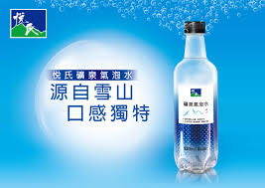
Optimize 【a1.png】 to meet SEO standards.
There is a picture of mineral water on the webpagea1.png
Optimize images to matchSEOSyntax:
<img src="a1-Environmentally friendly mineral water-Snow Mountain.png" alt="Environmentally friendly mineral water from the snowy mountains" title="Environmentally friendly mineral water from the snowy mountains" />

Slide 91
Optimize 【a1.png】 to meet SEO standards.
<img src="a1-Environmentally friendly mineral water-Snow Mountain.png" alt="Environmentally friendly mineral water from the snowy mountains" title="Environmentally friendly mineral water from the snowy mountains" />
src →OptimizationFile Name(English is better)Able toMore in line with ChineseSEOThis helps search engines understand the content of the image.
alt（AlternativeAlternative text)
Function:Image alternative text (Text）
When the image cannot be displayed(Network problem, or image missing)
or inVisually ImpairedUse a screen readerHour
altThe text provided by the attribute will be displayed or read
HelpsAccessibility aids,Enhance user experience

Slide 92
Optimize 【a1.png】 to meet SEO standards.
<img src="a1-Environmentally friendly mineral water-Snow Mountain.png" alt="Environmentally friendly mineral water from the snowy mountains" title="Environmentally friendly mineral water from the snowy mountains" />
title
Function:When the userwillMouse hoverWhen on the picture,Will show"Environmentally friendly mineral water from the snowy mountains",
This helps improve the user experience.

Slide 93
Question:
For a business website, should 【SEO keywords】 be handled internally, or should a marketing company be hired to do it?

Slide 94
Should the **SEO keywords** for a business website be managed internally or by hiring a marketing company?
method1: If you understand the principle, you can do it yourself
The company does it itself, and can make regular revisions and continuous optimizations
method2: If you don’t understand, outsource it to a marketing company
The price is not cheap
Cannot be constantly corrected

